Slide 1
Scouts

Slide 2
Scout missions (1st cycle): timeline
Issuing of ITT for "Scout Mission Concepts and System Consolidation studies”: May 2019 - done
Evaluation of proposals: September/October 2019 – done
Kick-off of system consolidation studies for up to 4 mission concepts: Dec 2019/early Jan 2020 – done
Completion of system consolidation studies: September 2020 – done
ACEO assessment of science/application value: 6-7 October 2020 – done
PB-EO decision for implementation of mission concept(s): 24-25 November 2020 – done
RFQ for implementation of selected mission concept(s): Q1 2021 – done
Kick-off of implementation phase of selected mission concept(s): Q4 2021 – done
Scout -1 CubeMAP:
Kick-off took place on 26 November 2021
KPGR#1 planned in June 2022
Final Acceptance Review in September 2024
Launch is planned 36 months after kick-off, in November 2024
Scout -2 HydroGNSS:
Kick-off took place on 8 October 2021
SRR board was successfully held on 12 January 2022
KPGR#1 was successfully held on 20 January 2022
Final Acceptance Review in August 2024
Launch is planned 36 months after from kick-off, in October 2024

Slide 3
First Call - Scout Mission: Selection Criteria
Relevance to EO Scientific Priorities – the scientific goals and mission objectives should be framed in reference to one or more of the scientific challenges identified in the Earth Observation Science Strategy for ESA (ESA SP-1329/1+2, 2015).
Scientific maturity – in relation to the science objectives and applications a demonstrated EO observing technique shall be outlined for which the selection of the measurement technique(s) is justified based upon derived observational requirements (exhibiting Scientific Readiness Level (SRL) higher than or equal to 4)
Uniqueness and complementarity – in relation to other means of addressing the scientific objectives, as well as the activities and plans of other organisations preparing similar space missions, to ensure that there is no overlap with other existing smallsat initiatives in Europe
Technical Maturity – demonstration of Technology Readiness Level (TRL) higher than or equal to 4 for all satellite(s)/instrument(s) critical technologies
Industrial Cost – Industrial cost ceiling of 30 M€ at 2019 e.c., including space segment development, adaptation of existing ground segment or ad hoc ground segment development, launch services and in-orbit commissioning
Timeliness – development schedule not exceeding 3 years from kick-off of mission implementation up to launch and timeliness with respect to user needs.

Slide 4
Scout missions
Following the evaluation of the 17 proposals received in reply to ESA ITT in August 2019, 4 Scout mission concepts have been selected to proceed to System Consolidation Studies (6 month planned duration, 400 k€ each)
4 System Consolidation Studies were kicked-off in December 2019/January 2020 with the following consortia:
CubeMAP (formerly ESP-MACCS for atmospheric processes in the Upper Troposphere and Stratosphere): GomSpace (DK) prime with RAL-SFTC (UK) as sub-contractor
HydroGNSS (GNSS-R for hydrological cycle: soil moisture, freeze/thaw in permafrost, above-ground biomass and ocean wind speed): SSTL (UK) prime with NOC (UK), Univ Nottingham (UK), Univ Sapienza (IT), IEEC (ES) and FMI (FI) as sub-contractors
NanoMagSat (monitoring of the Earth’s magnetic field and ionospheric environment): Open Cosmos (UK) prime with CEA-LETI (FR), IPGP (FR) and Univ Oslo (NO) as sub-cos
TANGO (monitoring of moderate to strong emission sources of CH4 and CO2): ISIS (NL) prime with TNO (NL), KNMI (NL), SRON (NL) and 3Dplus (FR) as sub-contractors

Slide 5
ACEO’s role in the Scout mission selection process
During 1st day of ACEO meeting on 6 October 2020, each consortium will make a presentation of their scientific dossier and ACEO members will have the opportunity to ask questions to the teams
During 2nd day of ACEO meeting on 7 October 2020, ACEO members will assess the scientific value of each mission concept:
    scientific and application merits of the proposed candidate concept
    credibility of the proposed plan to achieve the scientific objectives
ACEO will need to prepare a 1-page statement (max) per candidate on the scientific value as well as the scientific roadmap (without ranking)
This is not a full evaluation process (e.g. Earth Explorers) but an assessment of the Scout’s science/application value
Taking into account ACEO assessment of science/application value and the technical & programmatic assessment done by a panel of ESA experts, the ESA Executive will make a proposal for Scout mission implementation that will be submitted to PB-EO for decision on 24-25 November 2020

Slide 6



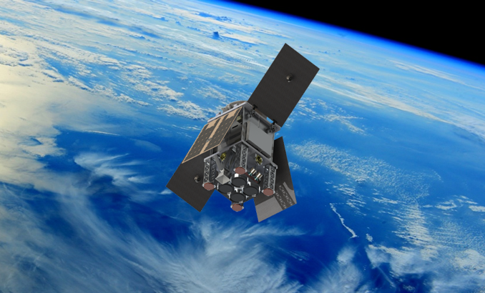














Scout missions concept
ESA’s approach towards embracing the concept of New Space through its FutureEO programme
Scout-1 – CubeMAP
Demonstrating the capability of SmallSat/CubeSat based satellites to deliver value-added science, for a maximum of 30 M€ (including space and ground segments, launch and in-orbit commissioning) within 3 years from kick-off to launch.
Scout missions take a unique position in between the established Earth Explorers and Copernicus missions:
Complementing EEs with (demonstration of) new sensing techniques and prototypes (but faster and cheaper).
Complementing Copernicus with potential fleets of SmallSats that successfully demonstrated miniaturisation of existing technologies (again faster and cheaper).
Terminated
Scout-2 – HydroGNSS
6
Notes:
Scout Missions Characteristics:
Very strict cost/schedule boundaries
3 years from Kick-Off to launch
Maximum 30M EUR industrial cost
Agile and good value for money
Agency’s response to a quickly evolving scientific and technological environment in the EO sector
Reduction of time and cost to deliver demonstrations of novel EO techniques and results in Earth sciences
Easily scalable if successful
Innovative implementation
Service contracts to provide scientific data
ESA role focused on critical risks with higher delegation to industry in direct contact with institutes and labs
Application of NewSpace standard

Slide 7
Scouts
Goal: foster concrete ideas for innovative smallsats, demonstrating EO techniques and/or enabling valuable science and (non-commercial) applications, based on low-cost approach and agile development
to advance the Earth Science agenda and/or demonstrate new EO techniques starting from elements with a higher maturity than Earth Explorers
to respond to the dynamism of a quickly evolving scientific and technological environment in the Earth Observation (EO) sector
to reduce the time and the cost to deliver demonstrations of novel EO techniques and incremental results in the Earth sciences and in related non-commercial applications, taking advantage of new development methodologies, high-risk approaches (e.g. use of Commercial Off The Shelf - COTS - components) and existing assets.
characterised by a very pro-active role of industry and academia (“co-engineering”) to realise a low-cost approach (industrial cost lower than 30 M€, including space segment, launch services, adaptation of existing ground segment or ad hoc ground segment development, and operations of the mission until end of the in-orbit commissioning phase) and a rapid development cycle (3 years from start of implementation to launch).
characterized by a low-cost (hence more agile) development process to prove new concepts for future ESA endeavours.
Mainly driven by programmatic constraints: Cost, schedule to enable new players
Science focus with some innovation features (e.g. sensing technique, miniaturization, distribution of functions on various small satellites), aim of providing incremental science either addressing niche applications on its own right or as complement to other missions.

