Slide 1
An overview of EUSPA opportunities for the downstream ecosystem
Ljubljana, Slovenia / SI Space Week
Vasilis Kalogirou, PhD / Space Downstream R&I Officer

Slide 2
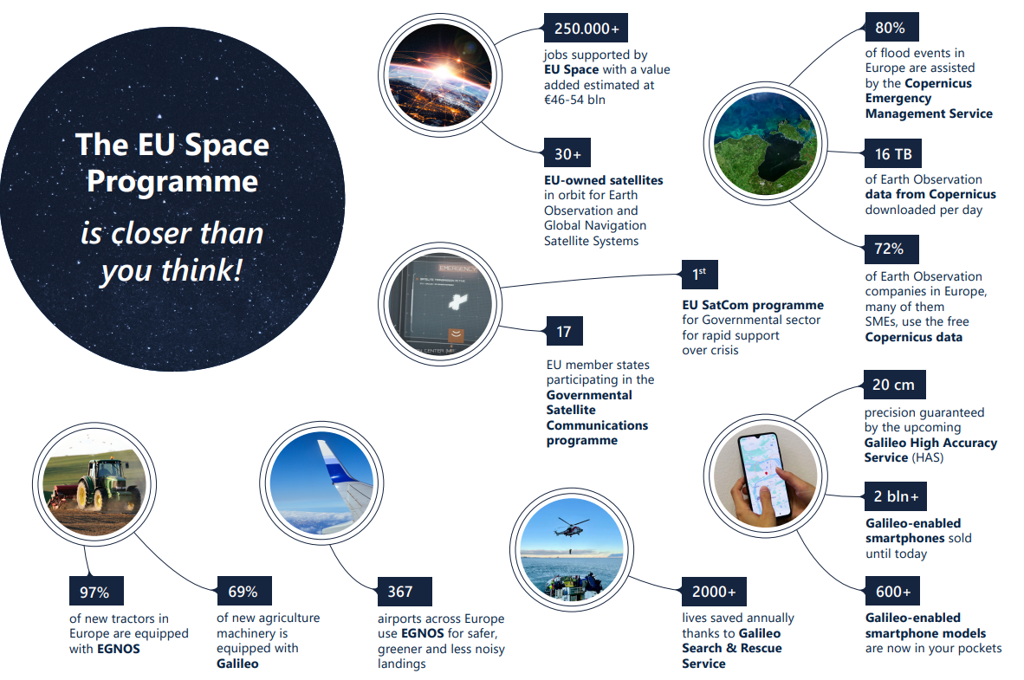

Slide 3




A new EU Space Programme and new Agency
With the new regulation, space data is at the heart of a technological revolution
EU space activities under one umbrella:
Galileo
EGNOS
Copernicus
GovSatCom
SSA
Global satellite navigation and positioning system (GNSS)
10% of the EU GDP enabled by satellite navigation
Makes navigation signals more accurate and reliable
Operational in 360+ airports & helipads in 23 countries
Earth Observation (EO) and monitoring based on satellite and non-space data
Nr.1 world provider of space data and information (>20TB/day)
Secures satellite communications for EU governmental actors
Delivering rapid support over crisis areas
Space Situational Awareness monitors and protects space assets.

Slide 4
A new EU Agency for the Space Programme
On the 12th May 2021, the GSA became the European Union Agency for the Space Programme (EUSPA)*
Vision
The user-oriented operational Agency of the EU Space Programme, contributing to sustainable growth, security and safety of the EU
Strategic Objectives
Deliver state-of-the-art, reliable, secure and performant services
Be a user and market-oriented EU Agency
Become a European and global reference for knowhow in space technologies and applications
Establish an efficient and fully compliant EU Agency, that learns continuously and that represents and works for the benefit of the Union
*Established under the Regulation of the European Parliament and of the Council establishing the space programme of the Union and the European Union Agency for the Space Programme and repealing Regulations (EU) No 912/2010, (EU) No 1285/2013, (EU) No 377/2014 and Decision 541/2014/EU (EUSPA Regulation)

Slide 5
EUSPA Mission in a nutshell
Implement and monitor the security of the EU Space Programme;
Manage the exploitation of Galileo and EGNOS and provide long-term, state-of-the-art safe and secure positioning, navigation and timing services;
Overarching coordination of user-related aspects of GOVSATCOM;
Communicate, promote, and develop the market for data, information and services offered by Galileo, EGNOS, Copernicus and GOVSATCOM;
Develop downstream applications based on the Programme’s components;
Contribute to fostering a competitive European industry for Galileo, EGNOS, and GOVSATCOM, reinforcing the autonomy, including technological autonomy, of the Union and its Member States;
Contribute to maximising the socio-economic benefits of the EU Space Programme by fostering the development of a competitive and innovative downstream industry for Galileo, EGNOS, and Copernicus, leveraging also Horizon Europe, other EU funding mechanisms and innovative procurement mechanisms;
Contribute to fostering the development of a wider European space ecosystem, with a particular focus on innovation, entrepreneurship and start-ups, and reinforcing know-how in Member States and Union regions.

Slide 6

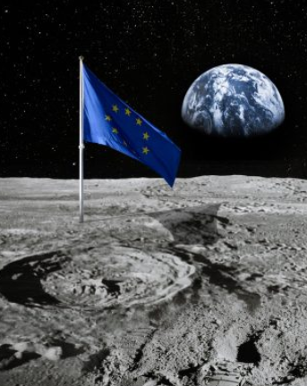
EUSPA to create Space opportunities for Everyone
EUSPA works:
For more start-ups and scale-ups in the space sector in all Member States,
For the emergence of a European New Space ecosystem to foster entrepreneurship
For greater cross-fertilisation of non-space sectors
For more awareness in Member States of funding tools
EUSPA support to Commission towards an upcoming Strategy on the uptake of space services (ongoing)

Slide 7












All EU Space Program components with an integrated market/user driven approach
Bodies influencing
the market
Navigation Signal
Providers
Chipset,
receiver
Devices
Content &
applications
Users
Bodies influencing
Data and services provision
Storage and processing
Content & Applications
Users
Market & User Knowledge
Demand
Support
Offer
Creation
Extended Market and technology monitoring and forecasting
Extended and synergic User Consultation Platform
Better understanding the MS needs and adding Copernicus Other Users satisfaction survey
A common market segments approach for all EU space downstream
Extended key account with main players of the value chain
Creation of new “made in Europe” products and services.
Large implementation of end-to-end solutions leveraging synergies.
Supporting entrepreneurship, SME and start-sups
New integrated segmentation

Slide 8
Offer
Creation

Slide 9




New opportunities for space downstream 2021-2027 - summary
Key Features
Horizon Europe – Cluster 4 “Digital, Industry and Space” - applications
Call 2021 : opened on 28 Oct 2021, closed on 16 Feb 2022 - GRANTS
Call 2022 : tentative opening on 27 Oct 2022, closing 16 Feb 2023
Horizon Europe EUSPA calls
Fundamental Elements
(Space Programme)
Development of receivers, chipsets and antennas – GRANTS/ PROCUREMENTS
Dedicated space support
Fundamental Elements
EGNSS/Copernicus in other Horizon Europe areas
Mandatory use of EGNSS/Copernicus in more than 100 Horizon Europe calls in 2021/2022 – GRANTS
list of calls
CASSINI
Seed and growth funding facility, hackathons, prizes, business accelerator, matchmaking for space Start-ups and SMEs – VARIOUS INSTRUMENTS
cassini.eu
EIC Instruments – grants and equity
EIC Pathfinder, EIC Transition and EIC Accelerator - GRANTS AND EQUITY
Open to space
EIC WP 2022 & space
Invest EU
1-7,5mio EUR indirect debt products, via commercial banks, backed by InvestEU guarantees (companies all industry sectors);
7,5 mio EUR – upwards, direct debt products, by EIB (InvestEU R&I and sustainable infrastructure products). Space companies eligible - LOANS

Slide 10

Horizon 2020 results (2014-2021)
16
188
PRODUCTS
&
78
PATENTS
PROTOTYPES
32
463
886
Contributions to
STANDARDS
PUBLICATIONS
EVENTS

Slide 11
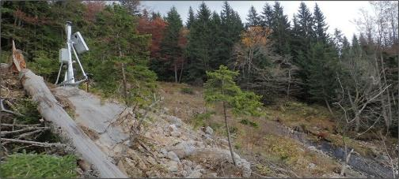

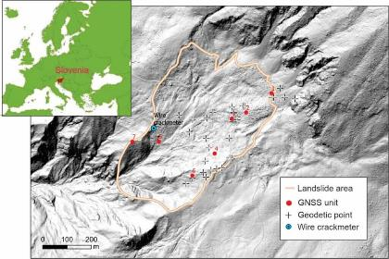





GIMS: Galileo for landslide prevention
Horizon 2020 success story
Low-cost system based on EGNSS, Copernicus and other in-situ sensors (EGNSS receivers and antennas, Inertial Measurement Units, inclinometers, and active SAR transponders), to monitor landslides and subsidence.
Recover deformations with millimetric level accuracy and provide real-time alerts in case of sudden movements, tested at Vipava Valley and Potoska Planina in Slovenia.
Have detailed and timely knowledge of the geophysical behavior to mitigate casualties and injuries and better plan maintenance intervention.

Slide 12
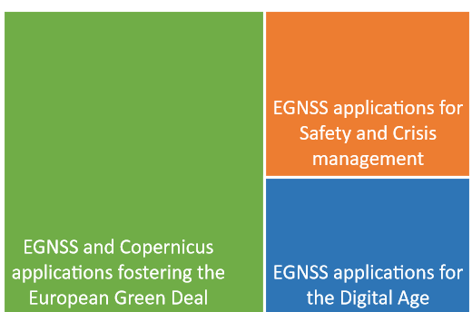
Horizon Europe 2021 (1st call)
Horizon Europe topics | Indicative budget (mln EUR) | Type of action
EGNSS and Copernicus applications fostering the European Green Deal | 14 | Innovation Actions
EGNSS applications for Safety and Crisis management | 9.3
EGNSS applications for the Digital Age | 9.3
Proposals received: 50
28
12
10
Submission period: 28 Oct 2021 – 16 Feb 2022
Overall budget of 32.6 million EUR
Current State: Evaluation – ongoing…
Innovation Actions -> activities aimed at producing plans and arrangements or designs for new, altered or improved products, processes or services // 70% funding rate – 100% for non-profit)

Slide 13
Horizon Europe 2022 (2nd call)
Type of Action | Topic | Indicative budget (EUR mln) | Funding rate
IA | EGNSS applications for Smart mobility | 9.5 | 70% (except for non-profit legal entities, where a rate of 100% applies)
PCP | Public sector as Galileo and/or Copernicus user | 5.2 | 100 %
IA | Copernicus downstream applications and the European Data Economy | 9.6 | 70% (except for non-profit legal entities, where a rate of 100% applies)
RIA | Large-scale Copernicus data uptake with AI and HPC | 9.6 | 100%
RIA | Designing space-based downstream applications with international partners | 5,1 | 100%
RIA | GOVSATCOM Service developments and demonstrations | 9,1 | 100%
TOTAL budget: |  | 48,1
Opening: 27 October 2022
Deadline: 16 February 2023
(indicative)

Slide 14
EUSPA Horizon Europe proposals shall…
Exploit the EU Space programme components, including EGNSS and Copernicus data and services.
Exploit EGNSS differentiators such as HAS, OS-NMA, Galileo Signal Authentication Service and SAR for the development of new innovative applications.
Deliver new innovative applications, with commercial impact and a clear market uptake.
A Business Plan and evidence of user engagement shall be compulsory and shall be provided as part of the proposal, to demonstrate the user need and sustainability of the project (for Innovation Actions).
Proposals addressing PRS (Public Regulated Service) related applications not in scope of action.
Proposals under this topic should exploit synergies and be complementary to national activities and activities funded by ESA.
Participation of industry, in particular SMEs and midcaps, is encouraged;
Participation of, or outreach to, entities based in countries without a space tradition is encouraged;
Involvement of post-graduate researchers (engineers, scientists, and others) is also encouraged, for example through professional work experience or through fellowships/ scholarships when applicable;

Slide 15
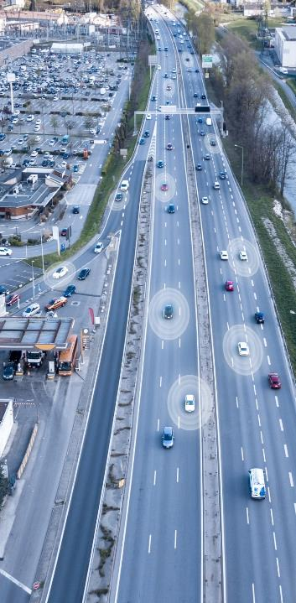

EGNSS APPLICATIONS FOR
SMART MOBILITY
HORIZON-EUSPA-2022-SPACE-02-51
9,5
Mio EUR
The action focuses on the development of close to market EGNSS transport applications and mobility services through the realisation of large scale demonstration and implementation projects.
Proposals may be submitted in any of the transport areas or propose a multi-mode approach:
  Aviation
  Maritime
  Rail
  Road
Activities are expected to achieve TRL 7-9 by the end of the project
Innovation Action

Slide 16

PUBLIC SECTOR AS GALILEO AND/OR COPERNICUS USER
HORIZON-EUSPA-2022-SPACE-02-52
5,2
Mio EUR
Demand-driven innovation by public authorities aiming at development and adoption of EGNSS/Copernicus applications which meet their needs.
Choice of market segment/ application left to the proposer, examples include EGNSS and/or Copernicus for: Monitoring of infrastructure (rail, road, critical infrastructure), Crisis emergency management, including related to extreme events Civil security applications and border management, Mobility as a service, cooperative ITS, public transport, smart cities and air quality monitoring and forecasting, Coastal area monitoring and modelling etc. | Aim: Foster exploitation of space applications to match needs of public authorities at national, regional or local levels Proposals should focus on clearly identified needs demonstrate sustainable solution beyond lifespan of the project Requested solutions should be validated through field-testing in at least two European countries.
Pre-Commercial Procurement
Photo: European Union

Slide 17

COPERNICUS DOWNSTREAM APPLICATIONS & THE EUROPEAN DATA ECONOMY
HORIZON-EUSPA-2022-SPACE-02-54
9,6
Mio EUR
Actions under this Topic will contribute to increase the integration and uptake of Copernicus into the economy, and/or to solve societal challenges.
Enable Copernicus penetration in many vertical domains , through sizeable and scalable applications enabled by modern ICT technologies.
Proposals are required to make use of existing European data infrastructures, such as Copernicus DIAS platforms, European open data portals, and industrial data platforms.
Applicants are required to present initial qualifying items of their business plan in the proposal, which will then have to be fully developed as part of the project’s exploitation plan.
Activities are expected to start at TRL 5 and achieve TRL 8 by the end of the project.
Innovation Action
TRL 8 – system complete and qualified
Photo: European Union

Slide 18

LARGE-SCALE COPERNICUS DATA UPTAKE WITH AI AND HPC
HORIZON-EUSPA-2022-SPACE-02-55
9,6
Mio EUR
Break data silos and allow discoverability, querying and linking between data infrastructures. Artificial Intelligence technologies, Linked Open Data paradigms and semantic archives able to scale to the full archives data volumes.
Connect Earth Observation data to European Data Spaces.
Develop new, enabling, scalable, operational solutions and technologies to improve capabilities and performance of the Copernicus value chain and supporting infrastructure.
Copernicus data assets and services at the core of the solutions.
Proposals can address individual elements of the value chain or the value chain as a whole.
Activities are expected to achieve TRL 5 by the end of the project.
Research & Innovation Action
TRL 5 – technology validated in relevant environment (industrially relevant environment in the case of key enabling technologies)
Credit: European Union

Slide 19

DESIGNING SPACE-BASED DOWNSTREAM APPLICATIONS WITH INTERNATIONAL PARTNERS
HORIZON-EUSPA-2022-SPACE-02-56
5,1
Mio EUR
To promote the uptake of Copernicus globally, exploiting possibilities for integrating in-situ, space data and information technologies.
Promote the uptake of Copernicus globally, enabling non EU countries to benefit from the advanced and unique features offered by EGNOS and Galileo, particularly in transport and regulated domains.
Maximise and spread the benefits of space-based applications and solutions enabled by EGNSS and/or by Copernicus, to leverage downstream space excellence in particular of SMEs and universities, to facilitate investments and to foster market uptake.
Create partnerships with non-EU entities towards commercialization, to trigger public and/or private investment from Europe and beyond.
Tasks may include joint calibration and validation activities or integration of local in-situ systems to enhance the quality of data and service products.
Technology promotion activities can include incentive schemes in the form of financial support to third parties, that will promote the uptake of space downstream applications across Europe and globally.
Research & Innovation Action

Slide 20
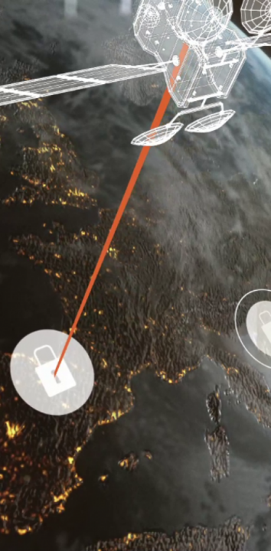
GOVSATCOM SERVICE DEVELOPMENTS & DEMONSTRATIONS
HORIZON-EUSPA-2022-SPACE-02-56
9,1
Mio EUR
Consolidation of security-related services, demonstrations in a user context and in particular for civilian users and synergies with the services provided by the other components of the Space Regulation (e. g. services for civil protection with Copernicus images).
This topic address service developments in support to all High Level User Needs, including direct involvement of users and with emphasis on civilian users and interoperability of services. This should include Pooling & Sharing demonstrations, in particular on services enabled by new technology developments such as ground segment, RPAS, optical communications or Internet of Things. Service development should include an element of awareness building and outreach.
Scope: R&I for the consolidation of integrated use cases and demonstration of EU GOVSATCOM service interoperability in real user environment:
    Development of an innovative use case exploiting a combination of secure SATCOM services and Fixed Satellite Service (FSS);
    Interoperability of services based on pooled and shared capacities, and interoperability of governmental satellite-based communication services with terrestrial ones;
    Development of end-to-end GOVSATCOM user services;
    Integrated application leveraging the synergies with services provided by other Space Programme components;
    Proof of concept in a real user environment;
    Awareness and outreach activities.
Research & Innovation Action
Specific security provisions (if the activities involve EU Classified Information)
Entities shall comply with the conditions of Article 24 of the Regulation (EU) 2021/696

Slide 22

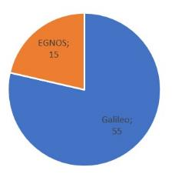
Fundamental Elements (1): a successful story
All grants and procurements launched
32 projects on-going covering all the market segments
11 projects successfully closed
FANTASTIC (Agriculture): a receiver with first implementation of OSNMA successfully tested under simulated spoofing attack at Joint Research Centre
ESCAPE (Road): first Galileo-based highly automated (Level 4) vehicle powered by Galileo, Multi-frequency and multi-constellation GNSS receiver
GLAD (Aviation): significant contributions to improvements in position integrity via ARAIM
GIANO and GEARS (T&S): Galileo-based timing platform (TRL7), using OSNMA and EGNOS corrections
H-GEAR (Road): OSNMA based anti-theft system with the eCall technology for motorbikes
MAREC (Maritime): guidelines for implementation of SBAS for SOLAS and non-SOLAS applications both for navigations equipment and for AIS
APOLLO (Mass Market): Galileo-based geolocation solution for the IoT market using Cloud computing
PHOENIX and TAUCETI: Development of MEOSAR Beacons in aviation and maritime
PATROL: Open Service Navigation Message Authentication (OS-NMA) user terminal for digital tachograph in road
Budget FE1
70 million €

Slide 23
Fundamental Elements (1): expected results from on-going projects
HAS implementation
Receiver in Agriculture and Mass Market
Drone-borne receiver (incl. OSNMA)
OS-NMA implementation
Maritime leisure boat (mooring and anti-theft)
Timing and Shipborne receiver
MEOSAR Beacons with Return Link in
Aviation and Maritime
Implementation of EGNOS SBAS in
Aviation and Maritime
Galileo powered autonomous driving prototype targeting level 4-5
Transversal
Hybridization of GNSS and Wi-Fi (TRL8)
Receiver prototype for IoT
Receiver for smart cities
DFMC antenna
Space receivers (2)

Slide 24
Further developments needed to fill the identified gaps
Strengthen the implementation of the EGNSS differentiators
Further implementation of OSNMA in specific use cases: Drones and consumer solutions
Achievement of PVT authentication via implementation of CAS in addition to OSNMA for Road/Autonomous Vehicles and Timing & Synchronization
Implementation of HAS in Agriculture, Surveying and Maritime
ARAIM (Advanced Receiver Autonomous Integrity Monitoring) receivers in Aviation, Maritime & Rail in the long term
New SAR Beacons for Maritime
Early Warning Services (EWS)
Transversal technologies
Miniaturization
Antennas
Integration of 5G in GNSS devices
Artificial intelligence
Machine learning
Focus on exploiting EGNOS SoL/SBAS
Fusion with Copernicus

Slide 25
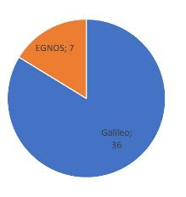
FE2 (2021-2027): main drivers
New development of receivers, antennas and enabling users technology:
  Continue to be driven by user needs and oriented for a commercial use:
      Priorities on specific segments driven by market needs, consultation with Users, with MS, with Industry/Academia
      Clear-cut from prototype receiver developments needed to leverage new services
  Operational implementation of current differentiators:
      E.g. OS-NMA and HAS, multi frequency
  Prepare for commercial implementation of new differentiators:
      Early Warning Service, CAS, ARAIM, …
  Develop emerging, disruptive technologies (e.g. leveraging ML/AI, etc.)
  Explore synergies with other space systems on user technology:
    E.g. Copernicus, SatCom
Budget FE2
43 million €

Slide 26


Slovenian startups supported through EUSPA Entrepreneurship Programmes
MyGalileoSolution
Winner!
65,000 EUR
VisionAnchor: Galileo for
safe anchoring
System made of an anchor buoy that's connected to an underwater camera and attached to the anchor.
Infrared camera for night monitoring and Wi-Fi connection enabling mobile application.
Notification and alarm system in case the anchor moves, improving safety at sea.

Slide 27

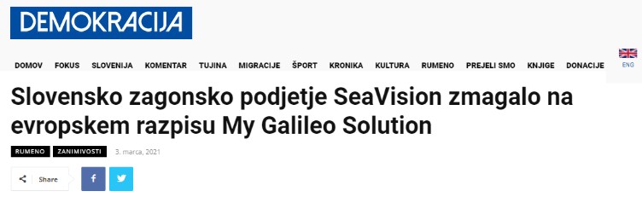

Slide 28
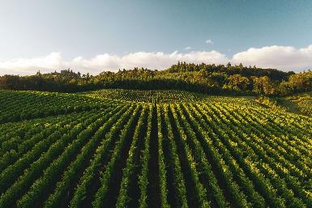
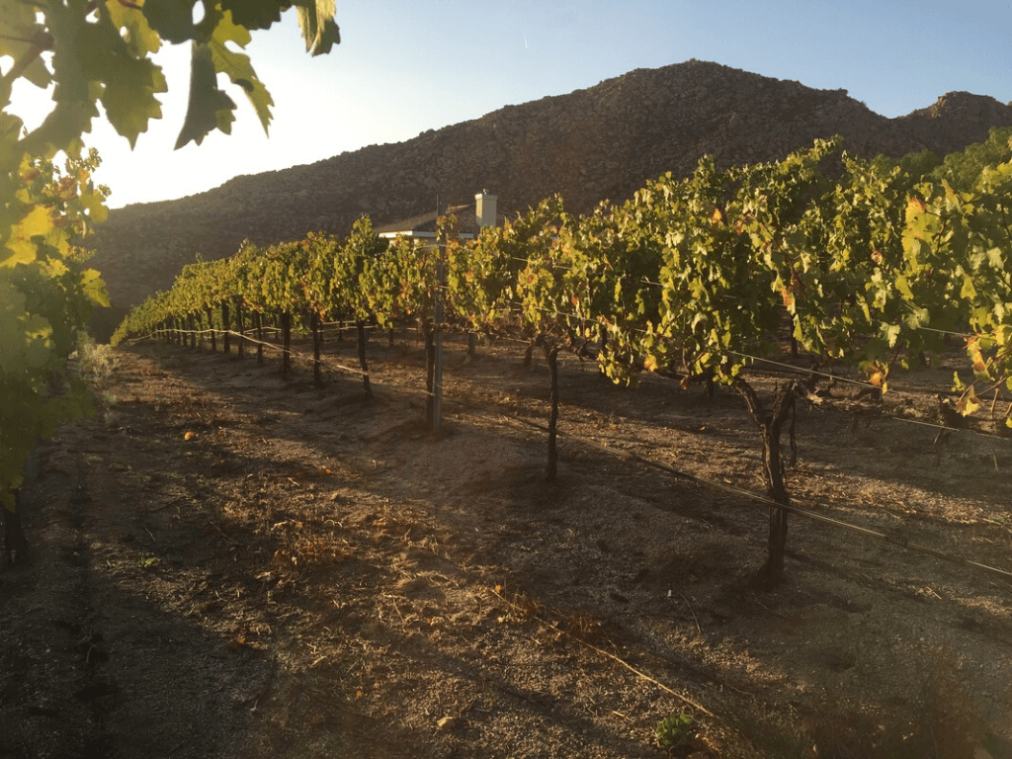
Slovenian startups supported through EUSPA Entrepreneurship Programmes
MyGalileoSolution
finalist
40,000 EUR
eVineyard YieldMap: Galileo for
agriculture
Vineyard management software to “help grow better quality grapes more sustainably”.
Cost optimization and planning across multiple sites.
Irrigation and pest development decision support based on vineyard data.

Slide 29

CASSINI Space Entrepreneurship Initiative
CASSINI is the Commission’s initiative to boost space entrepreneurship, tailored to the needs of Europe’s New Space industry

Slide 30

Why support space entrepreneurship?
New products and services:
  Space technology for new functionality and lower cost
  Digital services based on space data, information and services
New business models:
  Commercialisation of space
New financing schemes:
  Increasing role of venture capital funds
  Debt funding access requires customers & revenue
A closer cooperation between EC, EIF, ESA, and EUSPA, and others

Slide 31
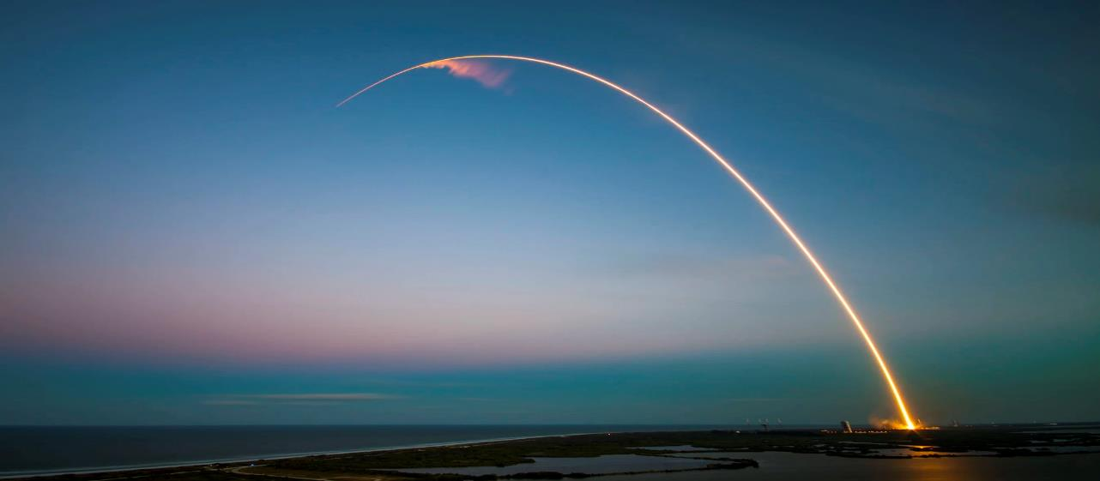
Cassini 2021-2027 overview
THE ROAD TO NEW SPACE
Clear vision for European space businesses and markets
New industry setup
New entrants
New private investment
New markets
New solutions
Starts 2022
MATCHMAKING
CASSINI Matchmaking with Investors
CASSINI Industrial Partnering
Starts 2022
BUSINESS GROWTH
CASSINI Business Accelerator
Starts 2022
PROMOTION
CASSINI Hackathons & Mentoring
INNOVATION COMPETITIONS
CASSINI Prizes
INVESTMENT
CASSINI Seed and Growth Funding Facility (InvestEU)
Started 2021
Starts 2022
cassini.eu

Slide 32
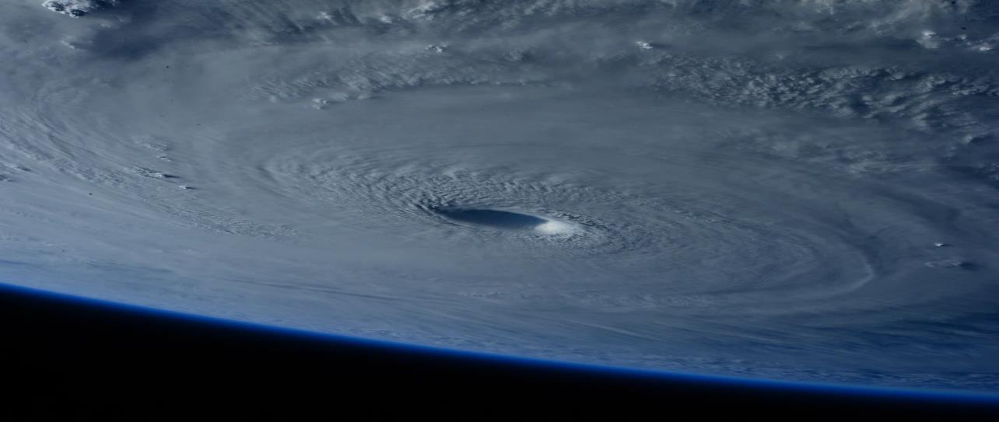
CASSINI supports entrepreneurship during the entire innovation cycle
IDEAS / INNOVATION
TECHNOLOGIES
EXPANSION AND GROWTH
Incentivising new ideas
Developing disruptive technologies
Increasing number of Venture Capital funds with focus on space
Connecting with VC funds and commercial partners
CASSINI Hackathons
CASSINI Prizes
Horizon Europe
European Innovation Council
CASSINI Seed and Growth Funding Facility
CASSINI Matchmaking

Slide 33







PROMOTION
CASSINI Hackathons & Mentoring
Discover the CASSINI Hackathons
6 Hackathons (2021-2023)
60 Local Organisers
10 per edition
Hybrid
Local
European
Global Themes
Why the CASSINI Hackathons?
Contributing toward solving important problems for society & industry
Fostering the next generation of entrepreneurs & problem solvers
Creating a truly a pan-European experience
Connecting industry with the EU Space ecosystem
https://hackathons.cassini.eu/

Slide 34

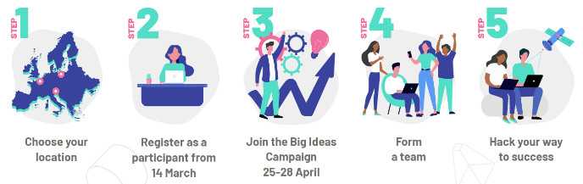



#3 Cassini Hackathon in May 2022
The 3rd Hackathon will challenge hackers to uplift the tourism sector with resilience, sustainability and digitalisation
4th CASSINI Hackathon on 3-5 November
three tourism-themed challenges:
#1
#2
#3
Finding sustainable destinations
Where to go and how to get there?
Experiencing cities and cultures
What to visit and who to meet?
Exploring nature with care
What outdoor activities to do?
Austria
Hungary
Italy
Portugal
Greece
Norway Netherlands
Denmark
Poland
France
Winners get cash prize +
100h of mentoring over a period of 6 months
Slovenia in the 4th CASSINI Hackathon??? Why not?
https://hackathons.cassini.eu/

Slide 35
Ideas/Innovation
CASSINI Prizes
CASSINI Prizes
Objective: to award Europe’s leading innovators developing break-through solutions in an innovation area defined by the prize
Outcome: close-to-market digital applications based on European space data
Prize reward will help winning companies to raise further investment
Open only for SMES that can participate with a consortium

Slide 36

CASSINI Maritime Prize coming soon
Opens for submissions Q2 2022
Prize for the best data-driven marine or maritime digital application
Solutions for the detection, monitoring and the removal of microplastics, plastic litter as well as of larger items in rivers, shores and coastal zones, in order to support the prevention of ocean pollution
Use of Copernicus and/or Galileo data in combination with other data sources. Use of Artificial intelligence, high performing computing, big data processing and management is also encouraged
First 3 winners will receive EUR 950.000 cash prize each
The CASSINI Prize will open for submissions at the EC's Funding & Tenders portal

Slide 37
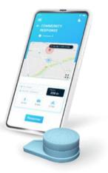
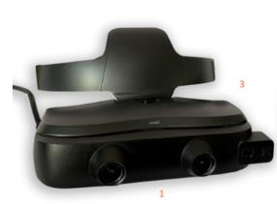
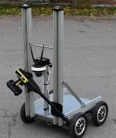
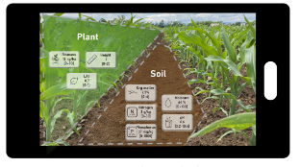
Other CASSINI Prizes: myEUspace prize contest
New myEUspace edition coming in Q3 2022!
Objective: stimulate innovation in Europe with the development of commercial solutions like mobile apps, wearables, robotics using EU space data and their synergies
Two tracks to:
  - incentivize new ideas
  - support existing solutions to scale up
mobile app & panic button for safety of women
Smart glasses for improving mobility of people with low vision
Six application areas addressing EU Green Deal, smart cities, sustainable mobility, optimization of the food chain
state-of the-art technologies with strong business concept
EUR 1 million prize pool, more than 40 innovators
mobile robot to replace human in Dirty-Dull-Dangerous jobs
mobile app for sustainable precision farming
myeuspacecompetition

Slide 38

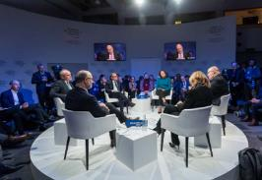
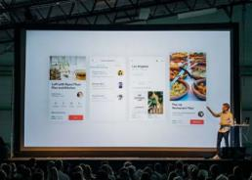
MATCHMAKING
CASSINI Matchmaking with Investors
CASSINI Industrial Partnering
CASSINI Matchmaking
Objective: Step-by-step support to start-up, scale-up companies and SMEs to improve their ability to attract venture capital funding and form industrial partnerships
Investor matchmaking: links between startups and VC funds
Industrial partnering: links between startups and large corporations
CASSINI Matchmaking will feature two tracks:
Startups, scaleups or SMEs can benefit from direct access to investors
Investors can get in touch with steady, high-performing companies with a great business solution
Corporations can fuel innovation and make their organisations fitter for the future

Slide 39

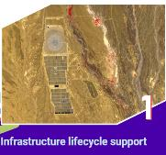
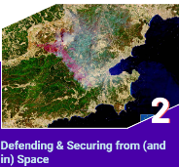


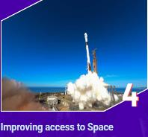

CASSINI Matchmaking themes 2022-23
How to apply
Applications now open!
Matchmaking evolving around four main thematic topics where startups can solve their business challenges and address global needs:
For companies:
For corporates:
For investors:
https://cassini.eu/matchmaking

Slide 40
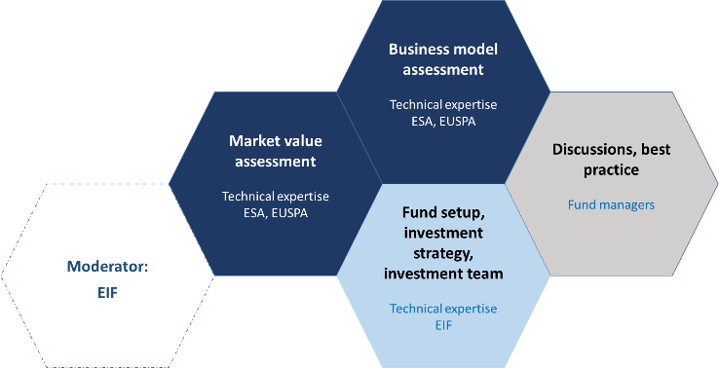
INVESTMENT
CASSINI Seed and Growth Funding Facility (InvestEU)
CASSINI Seed and Growth Funding Facility
Objective: €1 billion investment capacity, leveraging private capital and attracting new VC funds in Europe to invest in space-related companies
Eligible fund types: Venture capital funds, private equity funds and tech transfer funds
Eligible investment targets: Companies developing space technology (upstream) and digital services using space data (downstream)
When does the call open? Check the EIF press releases
Interested? Fund managers can contact EIF

Slide 41

BUSINESS GROWTH
CASSINI Business Accelerator
CASSINI Business Accelerator
CASSINI Business Accelerator 2021-2027
  Strengthening companies’ business development and go-to-market capabilities
  Improving companies’ access to risk financing
  Strengthening companies’ networks to other markets and larger companies
  → Implemented by Europe’s sharpest business accelerators

Slide 42

EUSPA support for start-ups under Cassini
Develop your solution
Get funding
Hackathons
Competitions
Development Programme
Connection to accelerators/incubators
Very early stage – EBAN, crowdfunding
Venture capitals
European Investment Bank
Horizon Europe, Fundamental Elements
EIC Accelerator
Investor events
Get advice
Get connected
Technical advice
Business advice
Pool of experts
Contacts with industry
Networking events
Dedicated promotion

Slide 43



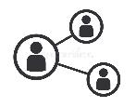
EUSPA is working closely with investors who can play a key role helping start-ups to reach market success
EUSPA has established partnerships with a wide variety private investors in order to cover the full spectrum of startup needs
Investors in our network include: business angels (EBAN), venture capitalists, crowdfunding platforms and investment banks (EIB)
Activities are organized in three categories:
Actions aimed at improving the startup offer
Actions aimed at increasing the interactions startups- investors - industry
Actions aimed at developing the investor network

Slide 44

Not sure what funding is available to your company?
Not sure what funding is available to your company?
Search for suitable funding sources in your country, by region, by type of funding and by industry sector:
Find the right place to start-up in different EU countries
Search for fundings

Slide 45
Market & User Knowledge

Slide 46
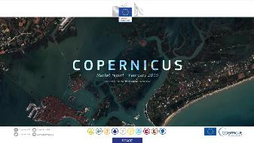
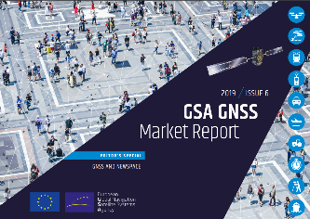
EO and GNSS Market report builds upon years of expertise
The EO and GNSS Market Report combines the market and application insights of
  Copernicus Market Report by the EC and
  six previous issues of the EUSPA GNSS Market Report
  into a single report that provides global coverage of the EO and GNSS applications across multiple market segments
In total 17 market segments were derived, taking into account as much as possible the specificities of both domains

Slide 47

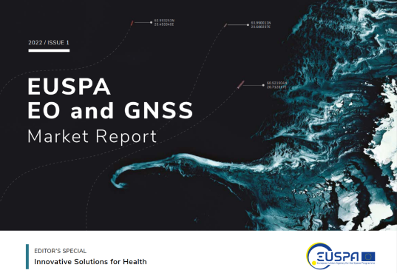
Content of EO and GNSS Market report
Get your free copy!
Available at EUSPA website:
https://www.euspa.europa.eu/sites/default/files/uploads/euspa_market_report_2022.pdf

Slide 48
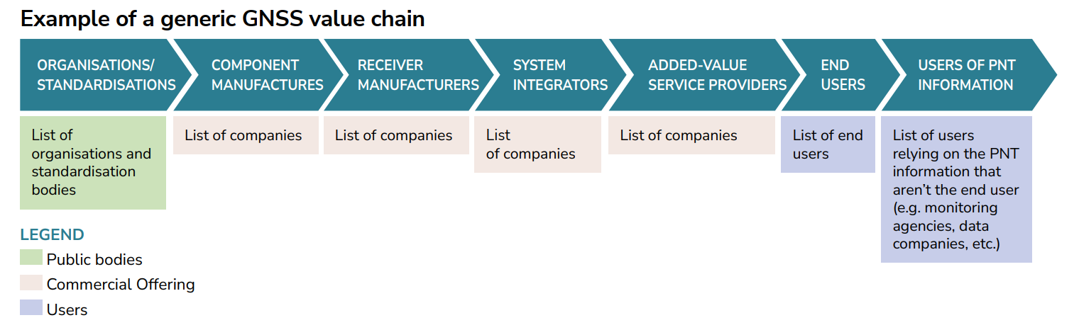
Generic GNSS value chain
(Inter)national organisations and standardisation bodies: Regulated segments such as Maritime, Aviation etc. will present a first link in their value chain dedicated to bodies setting GNSS standards and requirements (not present in each segment).
Component manufacturers: they underpin the industry by producing chips, antennas and other inputs for GNSS receivers.
Receiver manufacturers: they develop the GNSS receiver taking into account specific user requirements for the different applications/market segments they are active in.
System integrators (and design consultancies): responsible for the technical implementation of the GNSS equipment into a complex system.
Added-value service providers: these companies provide either added-value or augmentation services to end users (not present in each segment).

Slide 49

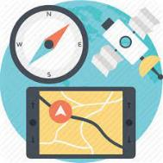


GNSS highlights from the report
“The global GNSS downstream market revenues from both devices and services will grow from almost €200 bn in 2021 to €500 bn in 2031 ”
“By 2031, more than 10 billion GNSS devices will be in use across the world”
“Global annual GNSS receiver shipments will reach 2.5 bn units by 2031, dominated by the applications falling under the Consumer Solutions, Tourism and Health segment which contributes to roughly 92% of global annual shipments”
“In terms of demand, the Asia-Pacific region continues to dominate the GNSS revenues market both for device and services revenues (i.e. 36% and 40% of the global share respectively in 2021)”
49

Slide 50
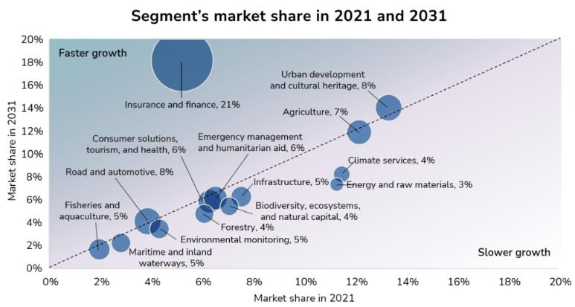
Segment`s EO market share
Segments in the darker zone are those which are projected to grow faster than others, while those in the lighter zone will experience slower growth (can be explained by the degree of maturity of the segment)
More mature market segments will experience smaller year-on-year growth than emergent markets in which the customer base is not yet well established.
  For instance, a mature segments such as Energy and Raw Materials has a slow and constant growth rate
  Conversely, Insurance and Finance is a rapidly increasing segment with high growth rate
Note: The size of the bubbles represent the CAGR of each segment between 2021 and 2031
Notes:
As presented in the figure, in which each segment’s market share growth is illustrated over the 2021-2031 timeframe for both data and value-added service revenues, the Insurance and Finance segment is expected to experience the fastest growth over the next decade. Segments in the darker zone are those which are projected to grow faster than others, while those in the lighter zone will experience slower growth. This can be explained by the degree of maturity of the segment. More mature market segments will experience smaller year-on-year growth than emergent markets in which the customer base is not yet well established. For instance, a mature segments such as Energy and Raw Materials has a slow and constant growth rate. Conversely, Insurance and Finance is a rapidly increasing segment with high growth rate.

Slide 51
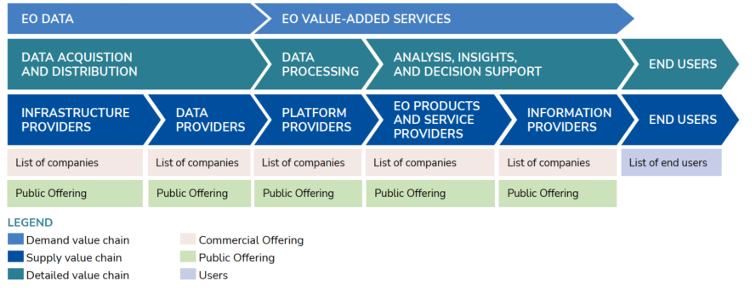
Generic EO value chain
The EO value chain is presented at three levels. At the highest level (light blue, demand), the market is split by EO data and EO value-added services majority of the charts
At the next level (green, supply), industry players fit into three categories:
Data acquisition and distribution
Data processing
Analysis, insights & decision support
Market share data
Notes:
At the lowest level (dark blue), the detailed value chain includes:
Infrastructure providers: providers of various types of computing infrastructure upon which EO data can be accessed, stored, distributed or manipulated.
Data providers: providers of unprocessed or pre-processed EO data.
Platform providers: providers of online platforms and/or digital services, through which users can utilise tools and capabilities to analyse EO data, develop algorithms and build applications.
EO products and service providers: providers of products (e.g. land cover classifications) or services (e.g. ground motion monitoring) that make full use of EO data and processing capabilities offered by data and platform providers.
Information providers: providers of sector-specific information that incorporates EO data along with non-EO data.
End Users: the final users who benefit from the applications and services offered by information providers.
Companies in Analysis, Insights & Decision Support market make use of EO data to provide information and intelligence to their clients seeking to solve complex geospatial challenges
Data acquisition and distribution companies supply commercial raw, unprocessed or pre-processed data. They include satellite, online platforms and data catalogues.
Data processing companies provide services used to process, calibrate, and analyse data, develop algorithms and build specific applications. The processing of data leads to change detection, mapping trends and the quantification of desired indicators on the Earth's surface.

Slide 52


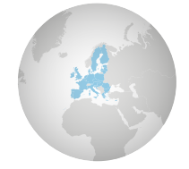
EO highlights from the report
“With revenues set to double from roughly €2.8 billion to over €5.5 billion over the next decade, the market for Earth Observation applications is boosted by a large pool of value-added services (i.e. 85% of global revenue)”
“The Insurance and Finance segment is expected to experience the fastest growth over the next decade for both data and value-added service revenues, boosted by the growing use and demand for parametric insurance products in the context of disaster resilience frameworks”
“Over half of global revenues (i.e. 55%) are generated by the top five segments, namely Urban Development and Cultural Heritage, Agriculture, Climate Services, Energy and Raw Materials, and Infrastructure”
“Although the European EO industry is dominated by SMEs and start-ups, from a supply perspective, European companies hold over 41% of the global EO market”
52
Notes:
BOTTOM RIGHT: Although the European EO industry is dominated by SMEs and start-ups, from a supply perspective, European companies hold over 41% of the global EO market. The downstream space application market accompanied by the EU Space Programme will continue growing and thereby effectively contributing to European (e.g. European Green Deal, EU's Digital Decade), as well as Global policies (e.g. United Nation’s Sustainable Development Goals and the Paris Agreement) in combination with other technologies.
TOP RIGHT: The Insurance and Finance segment is expected to experience the fastest growth over the next decade (2021-2031 timeframe) for both data and value-added service revenues, boosted by the growing use and demand for parametric insurance products in the context of disaster resilience frameworks. This segment is estimated to generate € 1bn in revenues by 2031.
BOTTOM LEFT: Looking at the top five segments within both the sales of value-added services and EO data, the Urban Development and Cultural Heritage, Agriculture, Energy and Raw Materials and Insurance and Finance each have secured their spot. Climate Services (under value-added services) and Consumer Solutions, Tourism and Health (under EO data) complete the top fives;

Slide 53

Content of the segment chapters
Example: Agriculture segment

Slide 54
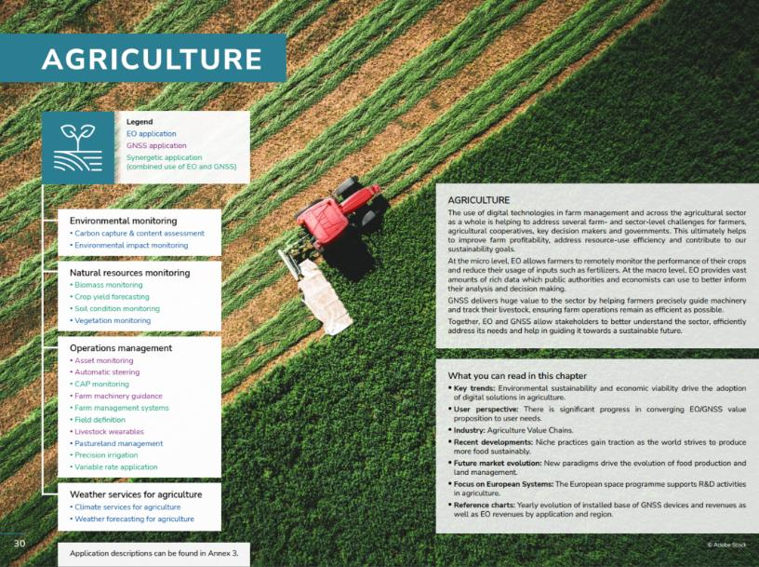
Segment`s content - First page

Slide 55
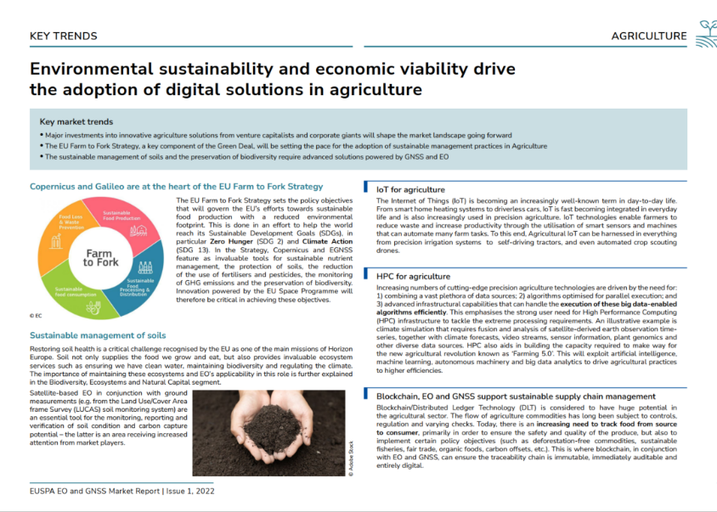
Segment`s content – Key trends

Slide 56
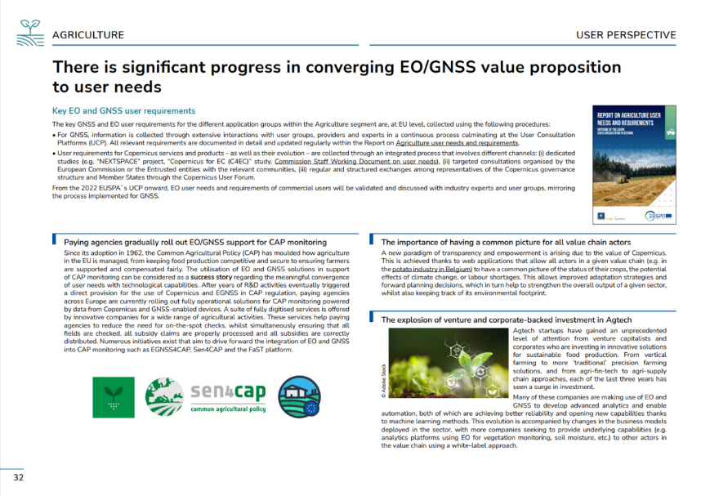
Segment`s content – User perspective

Slide 57
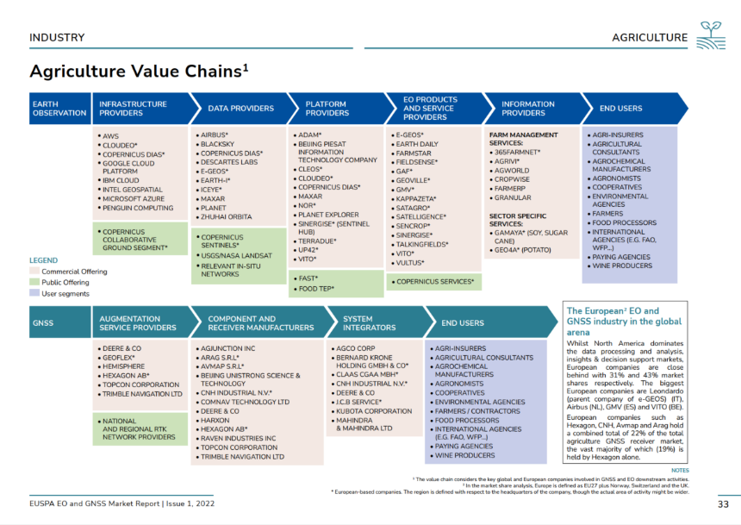
Segment`s content – Value Chains

Slide 58
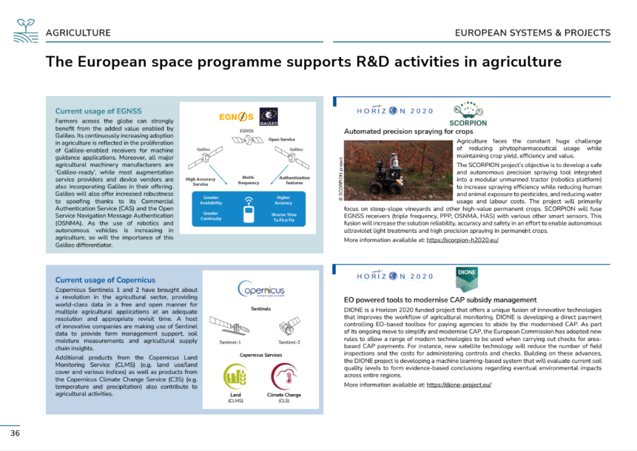
Segment`s content – European Systems and projects

Slide 59







Editor`s Special: Innovative solutions for Health
Focuses on how space-based data from GNSS and EO is used across the healthcare segment and presents the latest GNSS- and EO-enabled tools, used by people and governments all across the world to improve healthcare systems
Many applications covered in segments throughout the report play an important role for public health. More specifically we highlight developments such as:
Automation and digitalisation trends integrating spatial data for a more effective response to global health crises
EO and GNSS provide essential contributions toward better responses to evolving global health care needs
The role of location information for emergency situations
Earth observation data and services as a key instrument for addressing the invisible threat of air pollution
The contribution of EU space programme to support challenges faced by healthcare systems globally
Notes:
The Editor’s Special looks deeper into how space-based data from GNSS and EO is used across the healthcare segment and presents the latest GNSS- and EO-enabled tools, used by people and governments all across the world to and improve healthcare systems.
As shown in the adjacent figure, many applications covered in segments throughout this report play an important role for public health (circled in green). More specifically we highlight developments such as:
Automation and digitalisation trends integrating spatial data for a more effective response to global health crises: the digitalisation trend (e.g. eHealth) is highlighted through GNSS-enabled applications and EO data responses to the pandemic.
EO and GNSS provide essential contributions toward better responses to evolving global health care needs: this covers examples of the way the healthcare ecosystem can benefit from medical drone deliveries (especially in remote areas), GNSS-IoT trackers adapted for ageing population needs and the way EO data monitors can prevents future pandemics or outbreaks of (for example) Mosquito-Borne Diseases (MBDs).
The role of location information for emergency situations: GNSS takes emergency response to the next level as illustrated by the role of accurate positioning in each step of the emergency response chain (including access to automated external defibrillators and supporting Next Generation (NG) 112 architecture).
Earth observation data and services as a key instrument for addressing the invisible threat of air pollution: this comprises focusing on air quality guidelines by WHO, the contribution of EO data for Worldwide Analysis and Forecasting of Atmospheric Composition for Health, and monitoring the implementation of air quality legislation.
Finally we highlight the contribution of EU space programme to support challenges faced by healthcare systems globally.

Slide 60
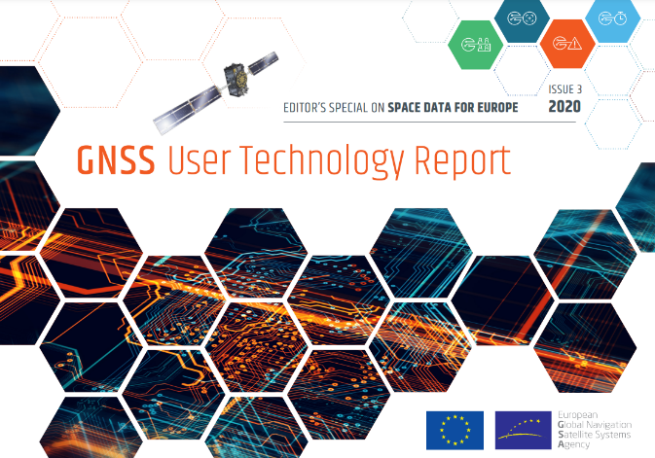
User Technology Report
Published every two years and takes an in-depth look at the latest state-of-the-art GNSS receiver technology, along with providing expert analysis on the trends that will shape the global GNSS landscape in the coming years
The third edition of GNSS User Technology Report presents an overview of the current GNSS user technology trends and developments across four macrosegments: high volume devices, safety- and liability-critical devices, high-accuracy devices, timing devices.

Slide 61







User Consultation Platform 2022
The UCP is engaging with other user communities, industries, service providers and R&D, bringing together expertise and insights from different applications, sharing experiences, and strengthening an EU network of innovators by encouraging cooperation across broad disciplines
UCP 2022 – 3, 4 October
Preparation started
Outcomes of the UCP are used to compile and update a series of Reports on User Needs and Requirements per market segment
INFRASTRUCTURES INCLUDING
5G OPTIMIZATION
MARITIME AND FISHERIES
Notes:
For the UCP there was the need to select subset of segments (because of budget constraints), after EUSPA internal evaluation taking into account criteria such as maturity of the segments, forecast growth and synergy among different components of the Space Programme Copernicus, GNSS and GOVSATCOM. The following 7 were selected:
1. Aviation & Drones
2. Maritime & fisheries
3. Emergency & humanitarian aid (this is more oriented to GNSS and GOVSATCOM)
Insurance & finance
5. Infrastructure (including 5 G optimisation)
6. Energy and Raw materials
7. Consumer solutions (inc. Tourism, healthcare)

Slide 62
Demand
Support

Slide 63

















Seventeen market segments
A common market segments approach for all EU space downstream

Slide 64

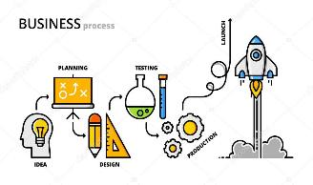
Addressing needs and gaps
Raise awareness of Copernicus in downstream markets and ecosystems, especially for commercial users (other users)
Close work with each ecosystem to identify needs and gaps
Facilitate access to EO data and services to non-EO users
Support ecosystems and communities through developing:
  Pilot projects to demonstrate suitability and replicability
  Copernicus-based products covering gaps within the ecosystem
  Best practices, standards, certifications and regulations
Foster synergies among program components.
In collaboration with ALL relevant actors in the EU EO ecosystem.

Slide 65




Copernicus for 5G/6G deployment
EU Space is an integral part of Europe’s digital infrastructure and ecosystem
Cellular networks are at the core of digital infrastructures enabling Europe’s digital transformation (IoT, autonomous vehicles etc.)
EU Space can accelerate and optimise the implementation of the cellular networks of the future such as 5G and 6G
The EU has set ambitious targets in the Digital Decade aiming at 100% 5G coverage of populated areas in 2030
The objective is to demonstrate the value of EU Space for the optimisation of the 5G/6G implementation
The digital ecosystem will be engaged in running a technical validation of the use of Copernicus and Galileo data
Copernicus provides geospatial data utilised for optimised network planning, operation and maintenance
Galileo provides critical infrastructure such as Timing & Synchronisation for the functioning and resilience of the networks
Activities included
Analysing the state of the art, user needs and market trends
Running a stakeholder consultation within the digital ecosystem
Defining the value proposition of EU space data in 5G/6G infrastructure deployment
Designing a Proof of Concept and running a technical validation
Providing a set of recommendations for the market uptake of EU Space data in cellular network deployment
Duration: 8 Months

Slide 66
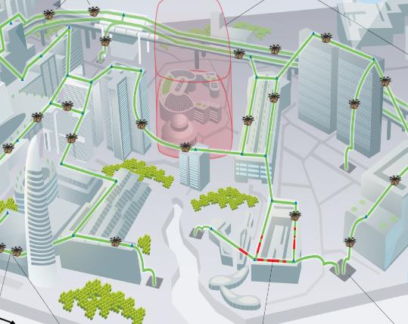
Copernicus for drones
Drones need to be integrated safely in the airspace
High interest in urban air mobility: delivery and air taxis
Operations planning process is more demanding in order to consider in advance:
  Populated areas
  Hazards
  Pollution
Knowing the actual ground elements and indicators on human activity, hazardous elements, as well as climate is essential for safety assessment and flight planning.
CLMS and CAMS data are relevant sources to harmonise drone operations planning and safety case.
Reality project presentation. UCP 2020
Duration: 6 Months

