Slide 1
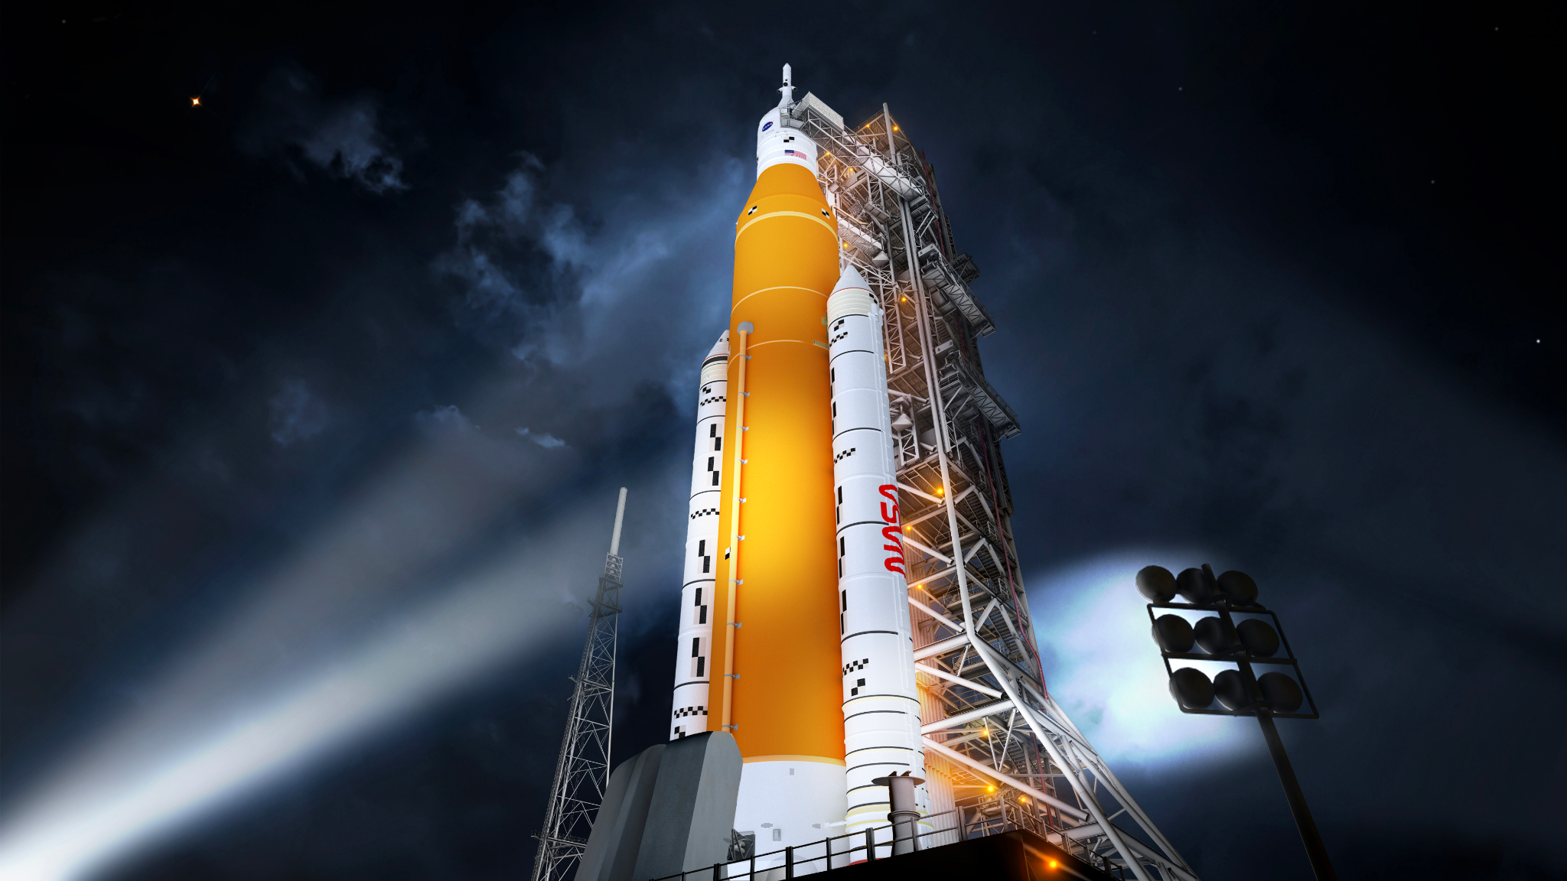
Collaboration Opportunity with the NASA Space Apps Challenge – Sežana
Hello there,
My name is Dorijan Maršič and I am the Local Lead of the Inkubator Sežana Local Event of the NASA International Space Apps Challenge. We are very excited to be hosting in-person again October 5th - 6th 2024 and expect a full house!
Since its inception in 2012, Space Apps, a part of NASA’s Earth Science Division, has become the world’s largest annual global hackathon. Space Apps engages thousands of individuals and teams each year across the globe to work with NASA data in the building of innovative solutions to challenges we face on Earth and in space. Space Apps inspires local innovation communities in cities across six continents to convene, ideate, and build. Diverse and collaborative teams of technologists, scientists, designers, entrepreneurs, and others work together in a 48-hour sprint to develop answers to some of the most pressing challenges in Space and facing planet Earth. Space Apps 2023 welcomed 31,500+ participants from 162 countries/territories, producing 3,000+ projects in response to Earth Science challenge statements written by NASA.
This year at the Inkubator Sežana event we are very interested in collaborating with your organisation in order for our participants to gain access to any tool, product or platform useful for their challenge. We believe that bringing your technology and knowledge to our Local Event would benefit the participants.
Space Apps is funded by NASA's Earth Science Division through a contract with Booz Allen Hamilton, Mindgrub, and SecondMuse.
For more information, visit
spaceappschallenge.org

Slide 2
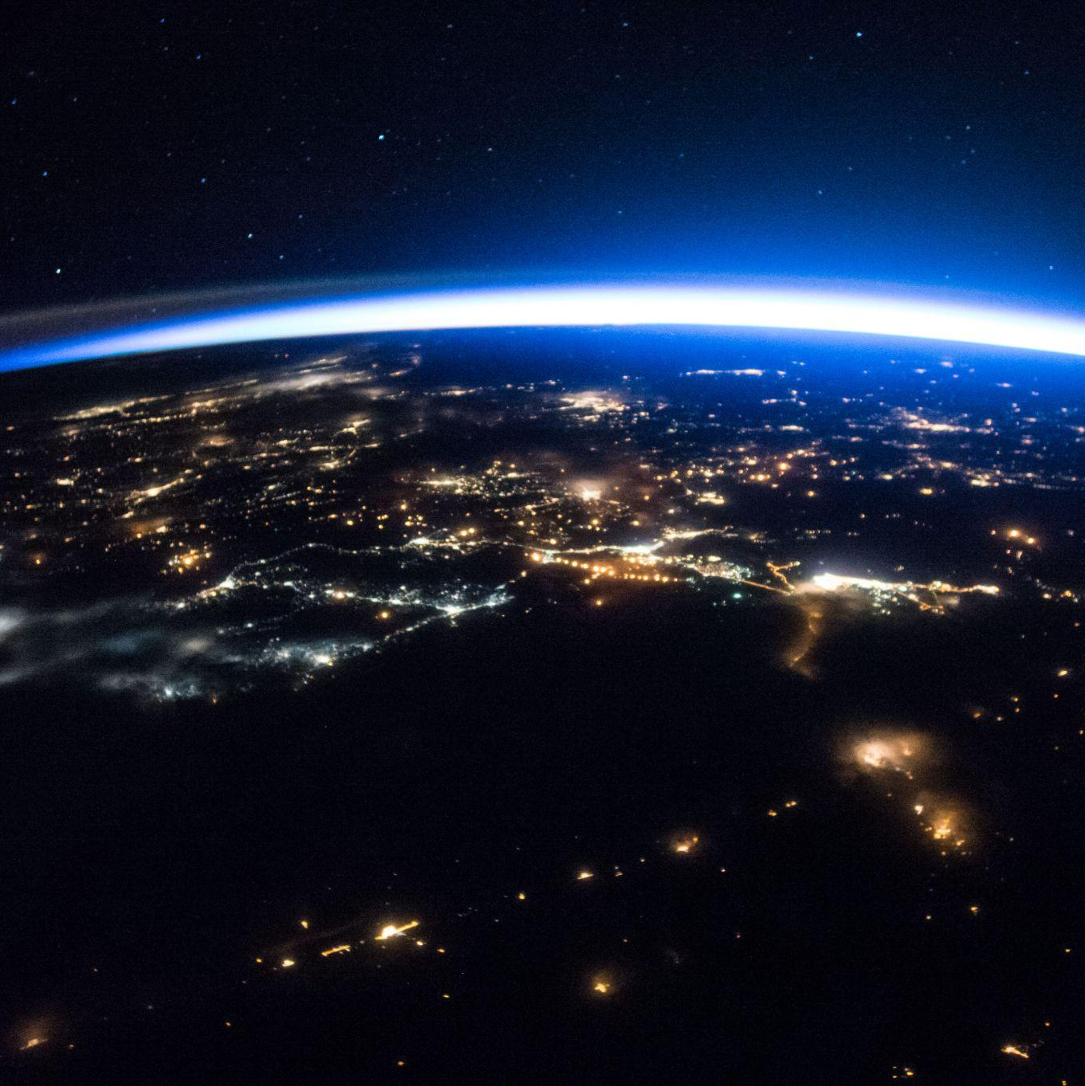
If you are interested we could potentially work together in following ways:
1. Providing access to the tool, product or platform at no cost to the participants.
2. Having someone from your organisation present at the event to mentor participants on how to use the tool.
3. Having your organisation give a 1 hour workshop to participants on uses of the tool and its relevance to the challenges.
4. Any other way you can think of, we are open to ideas!
We’d also love to feature your logo on our marketing materials and social media posts to let everyone know we’re working together! In return we’d ask that once the registration link goes live that you would also share the word about our event!
If you’re interested, we’d love to chat more about this opportunity to work together! We look forward to working together at the Sežana event of the NASA Space Apps Challenge. If you have any questions I’m happy to answer!
Inkubator Sežana, Kraška ulica 2, 6210 Sežana
info@inkubator.si
+386 5 7313 500
/spaceappssezana
Dorijan Maršič
JOIN US Local Lead
Call To Action copy goes here. Quis sundio cullesequi cus as quas aute officipsam sitatur aut vendit, apidebit, utem hicaerchic tota quis soluptur sed ut ut porrum,
Space Apps is funded by NASA's Earth Science Division through a contract with Booz Allen Hamilton, Mindgrub, and SecondMuse.
For more information, visit
spaceappschallenge.org

